Slide 1

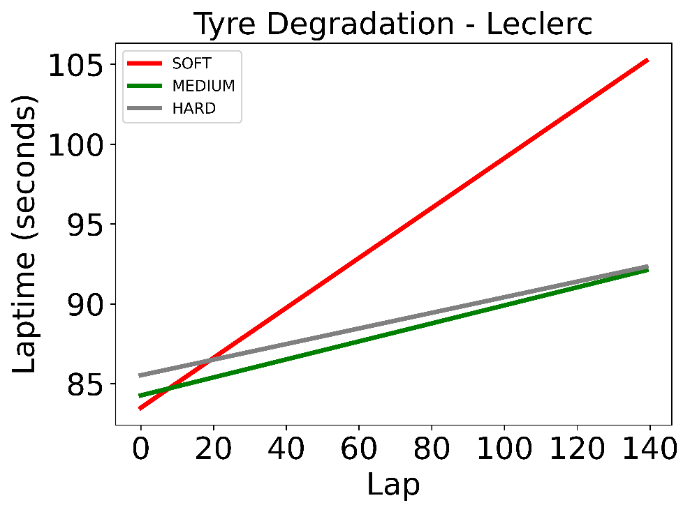
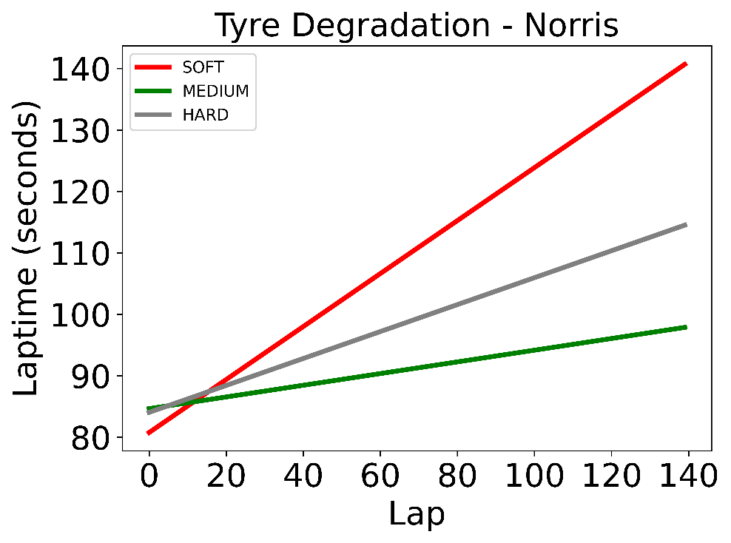
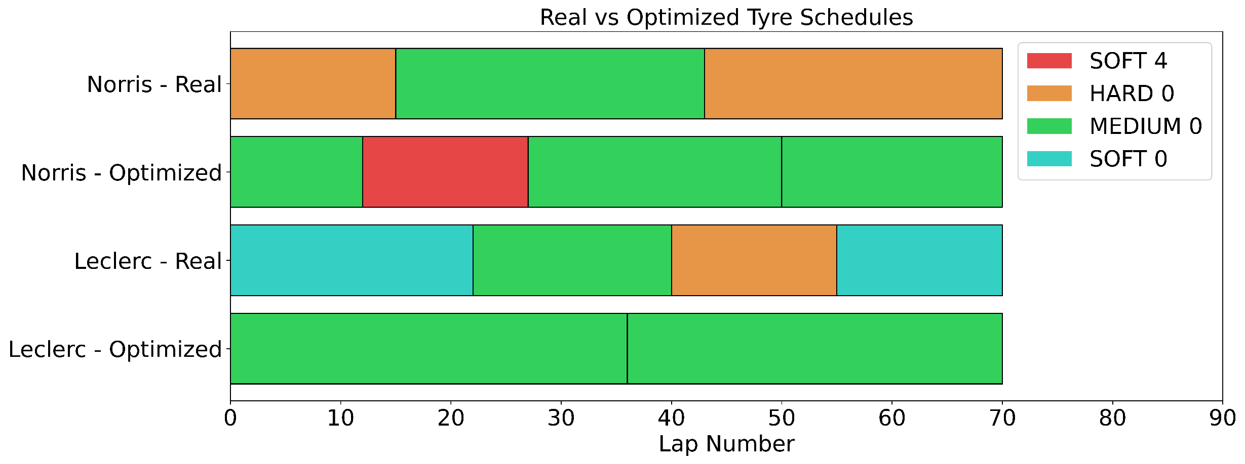
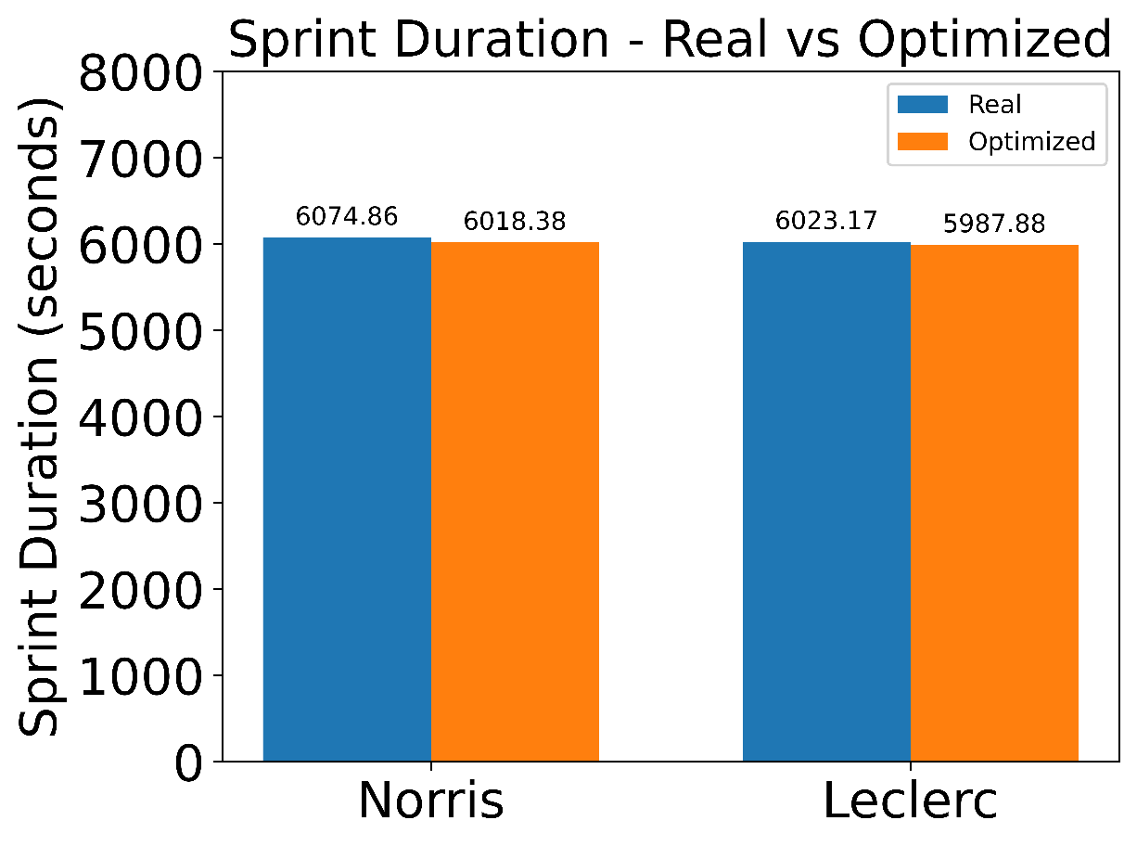
Optimization of Tyre Selection and Pit Stop Strategies
Christopher Quinn (CCSE)
Demetrios Kriezis (EECS)
Executive summary
What are the data?
What is the impact?
We formulated and implemented a binary optimization problem that minimizes the sprint duration time of a Formula One racing session.
The output is an optimal pit stop strategy and tyre choice that minimizes the sprint duration time of a Formula One racing session.
We tested it for two drivers in the 2022 Hungary, Budapest and found that an optimal schedule will shorten their sprint duration.
The optimization problem can be used in planning or in real-time.
Planning - pit stop teams can coordinate with race car drivers to determine a pit stop and tyre selection strategy ahead of time.
Real-time strategy adaptation – teams can use the optimization model during a race and change strategy as new data or conditions arise. Example: weather affects the lap times of tyres and rain could influence the data.
The strategy obtained by optimization can improve a team’s score and dramatically change the race.
Problem statement
Laptimes per tyre choice were extracted from the data above
The pit stop time is an average pit stop time
Objective: Minimize the sprint duration
Decisions:
Choice to pit stop for 22 seconds after every lap
Choice of tyres from a set of available tyres to replace during a pit stop
Constraints:
13 tyre sets available
Some tyres might be partially used
Data:
Laptime per lap per tyre choice
Pit stop
What are the key findings?
If you had another week, what would you do?
Obtain realistic time estimates from a formula one simulator and generate a better data set.
OR
Incorporate robust optimization modeling to introduce uncertainties in the data. Uncertainties can come from:
Weather conditions.
Crashes from other drivers and road obstructions.
Other
OR
Introduce non-linearity into data from the weight of the vehicle getting lighter due to fuel consumption, which depends on the previous tyre choices since the fuel consumption depends on the elapsed time.
Why do we care?
Tyre choice can shave seconds from a driver’s total time.
Both drivers did not use the optimal tyre choice and could improve their sprint duration.
To increase our chance of winning a race, or at least rank as high as possible.
To increase our chance of placing higher in the qualifying session to gain an advantage in the actual race.
Enumerating choices is too slow – billions of choices to evaluate!
Sponsorship money.
Fame and Glory!
Norris can improve by 56 seconds.
Leclerc can improve by 36 seconds.
All else equal, Norris could’ve beat Leclerc if he used optimal schedule.
15.071—The Analytics Edge Fall 2019
15.093—Optimization Fall 2022

